Slide 1
Selection

Slide 2
We’re going to cover…
at a high level for now
Talk about what selection is
Provide an example of when selection is necessary
we've touched on the example I'll show in previous weeks

Slide 3
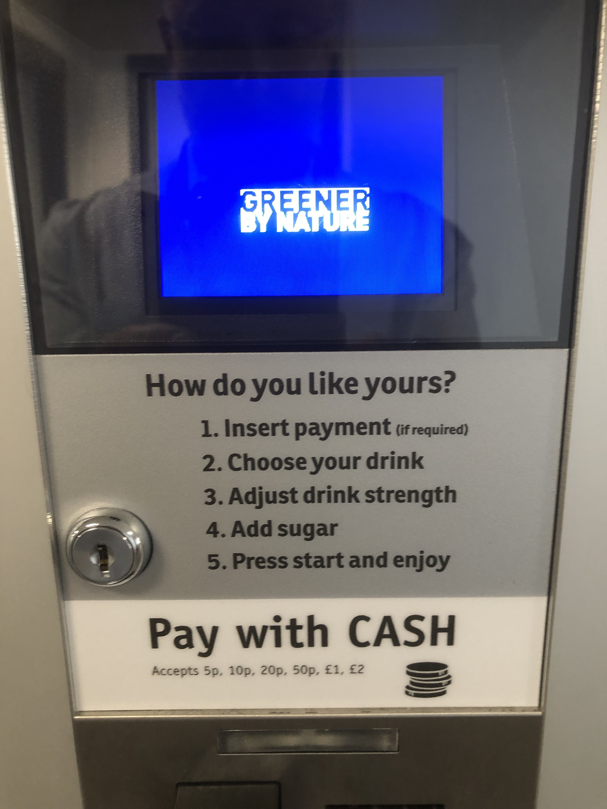
Everyday example of selection
let's start with a recap
Insert payment (if required)
Required
Not required
Choose your drink
Coffee?
Tea?
Hot Chocolate?
Adjust drink strength
Weak?
Normal?
Strong?
Add sugar
Add?
Don't add?
Press start and enjoy
we saw that there were choices to be made here

Slide 4
Do different actions result?
Insert payment (if required)
the user pays for their drink
the user doesn't pay for their drink
Required
Not required
Choose your drink
the user gets coffee
the user gets tea
the user gets hot chocolate
Coffee?
Tea?
Hot Chocolate?
Adjust drink strength
the user gets a weak drink
the user gets a normal drink
the user gets a strong drink
Weak?
Normal?
Strong?
Add sugar
the user gets sugar in their drink
the user doesn't get sugar in their drink
Add?
Don't add?
Press start and enjoy
just press start
what does that mean? how does execution in selection differ from a sequence?

Slide 5
Do different actions result?
Insert payment (if required)
the user pays for their drink
the user doesn't pay for their drink
Required
Not required
Choose your drink
the user gets coffee
the user gets tea
the user gets hot chocolate
do all of these actions occur?
Coffee?
Tea?
Hot Chocolate?
Adjust drink strength
the user gets a weak drink
the user gets a normal drink
the user gets a strong drink
Weak?
Normal?
Strong?
Add sugar
the user gets sugar in their drink
the user doesn't get sugar in their drink
Add?
Don't add?
Press start and enjoy
just press start
what would cause them to occur?
what would prevent them from occuring?

Slide 6
Do different actions result?
Insert payment (if required)
the user pays for their drink
the user doesn't pay for their drink
Required
Not required
cannot occur
Choose your drink
the user gets coffee
the user gets tea
the user gets hot chocolate
cannot occur
Coffee?
Tea?
Hot Chocolate?
cannot occur
the user gets a weak drink
the user gets a normal drink
the user gets a strong drink
Adjust drink strength
cannot occur
cannot occur
Weak?
Normal?
Strong?
Add sugar
cannot occur
the user gets sugar in their drink
the user doesn't get sugar in their drink
Add?
Don't add?
Press start and enjoy
just press start
for example, after having to pay, the user selects:
coffee
strong
no sugar

Slide 7
What do the actions depend on?
Insert payment (if required)
depends on whether the vending machine is in payment mode or not
Required
Not required
the machine's state
Choose your drink
depends on what drink the user selects
Coffee?
Tea?
Hot Chocolate?
user choice
Adjust drink strength
depends on what strength the user selects
Weak?
Normal?
Strong?
user choice
Add sugar
depends on whether the user wants to add sugar or not
Add?
Don't add?
user choice
Press start and enjoy
doesn't depend on anything – just press start

Slide 8
What do the actions depend on?
Insert payment (if required)
depends on whether the vending machine is in payment mode or not
Required
Not required
Choose your drink
depends on what drink the user selects
Coffee?
Tea?
Hot Chocolate?
Adjust drink strength
depends on what strength the user selects
Weak?
Normal?
Strong?
Add sugar
depends on whether the user wants to add sugar or not
Add?
Don't add?
Press start and enjoy
doesn't depend on anything – just press start
try to phrase these as true or false conditions

Slide 9
As true/false conditions
Insert payment (if required)
if the vending machine is in payment mode then wait for payment else don't wait for payment
Required
Not required
Choose your drink
Coffee?
Tea?
Hot Chocolate?
Adjust drink strength
Weak?
Normal?
Strong?
Add sugar
Add?
Don't add?
Press start and enjoy

Slide 10
As true/false conditions
Insert payment (if required)
if the vending machine is in payment mode
then wait for payment
else
don't wait for payment
Required
Not required
Choose your drink
Coffee?
Tea?
Hot Chocolate?
Adjust drink strength
Weak?
Normal?
Strong?
Add sugar
Add?
Don't add?
Press start and enjoy

Slide 11
As true/false conditions
Insert payment (if required)
if the user chooses coffee then give the user coffee else if the user chooses tea then give the user tea else if the user chooses hot chocolate then give the user hot chocolate
Required
Not required
Choose your drink
Coffee?
Tea?
Hot Chocolate?
Adjust drink strength
Weak?
Normal?
Strong?
Add sugar
Add?
Don't add?
Press start and enjoy

Slide 12
As true/false conditions
Insert payment (if required)
if the user chooses coffee
then give the user coffee
else if the user chooses tea
then give the user tea
else if the user chooses hot chocolate
then give the user hot chocolate
Required
Not required
Choose your drink
Coffee?
Tea?
Hot Chocolate?
Adjust drink strength
Weak?
Normal?
Strong?
Add sugar
Add?
Don't add?
Press start and enjoy

Slide 13
As true/false conditions
Insert payment (if required)
if the user chooses coffee
then give the user coffee
else if the user chooses tea
then give the user tea
else if the user chooses hot chocolate
then give the user hot chocolate
Required
Not required
Choose your drink
Coffee?
Tea?
Hot Chocolate?
is this condition necessary? could we remove it?
Adjust drink strength
Weak?
Normal?
Strong?
Add sugar
Add?
Don't add?
Press start and enjoy

Slide 14
As true/false conditions
Insert payment (if required)
if the user chooses coffee
then give the user coffee
else if the user chooses tea
then give the user tea
else
give the user hot chocolate
Required
Not required
Choose your drink
Coffee?
Tea?
Hot Chocolate?
Adjust drink strength
Weak?
Normal?
Strong?
Add sugar
Add?
Don't add?
Press start and enjoy

Slide 15
As true/false conditions
Insert payment (if required)
how would you phrase this as true/false conditional actions?
Required
Not required
Choose your drink
Coffee?
Tea?
Hot Chocolate?
Adjust drink strength
Weak?
Normal?
Strong?
Add sugar
Add?
Don't add?
Press start and enjoy

Slide 16
As true/false conditions
Insert payment (if required)
if the user chooses weak
then make the drink weak
else if the user chooses normal
then make the drink normal
else
make the drink strong
Required
Not required
Choose your drink
Coffee?
Tea?
Hot Chocolate?
Adjust drink strength
Weak?
Normal?
Strong?
Add sugar
Add?
Don't add?
Press start and enjoy

Slide 17
As true/false conditions
Insert payment (if required)
and this one?
Required
Not required
Choose your drink
Coffee?
Tea?
Hot Chocolate?
Adjust drink strength
Weak?
Normal?
Strong?
Add sugar
Add?
Don't add?
Press start and enjoy

Slide 18
As true/false conditions
Insert payment (if required)
if the user chooses sugar
add sugar
Required
Not required
Choose your drink
Coffee?
Tea?
Hot Chocolate?
Adjust drink strength
Weak?
Normal?
Strong?
Add sugar
Add?
Don't add?
Press start and enjoy

Slide 19
Selection
If you say 'if' while talking about a problem
What condition determines the action to be taken?
What action(s) need to be taken if the condition is true
What action(s) (if any) need to be taken if the condition is false
if the vending machine is in payment mode
then wait for payment
else
don't wait for payment
this isn't really an action so we could get rid of the else clause

Slide 20
Walkthrough
(just the planning)
Task 3 – Heads or Tails
Project Name: coin_toss
Beginner
Write a program that simulates the toss of a coin and asks the user to guess whether it was "Heads" or "Tails".
If the user guesses correctly, the program should output "You guessed correctly!", else the program should output "You guessed incorrectly".
we still need to know
what data is being used
what the sequence of actions is
we also need to know
are any of the actions conditional?
if so, what is/are the condition(s)

Slide 21
Walkthrough
(just the planning)
Task 3 – Heads or Tails
Project Name: coin_toss
Beginner
Write a program that simulates the toss of a coin and asks the user to guess whether it was "Heads" or "Tails".
If the user guesses correctly, the program should output "You guessed correctly!", else the program should output "You guessed incorrectly".
if we use random, this could be an integer (0 or 1)
if the user types in "heads" or "tails" as their guess then this would be a string
(we used the random module in week 1)

Slide 22
Walkthrough
(just the planning) (data)
Task 3 – Heads or Tails
Project Name: coin_toss
Beginner
Write a program that simulates the toss of a coin and asks the user to guess whether it was "Heads" or "Tails".
If the user guesses correctly, the program should output "You guessed correctly!", else the program should output "You guessed incorrectly".
if we use random, this would be an integer (0 or 1)
if the user types in "heads" or "tails" as their guess then this would be a string
if we get 0 we could say that the coin toss was "Heads" else we could say it was "Tails".
we could then see if the strings match

Slide 23
Walkthrough
(just the planning) (sequence)
Task 3 – Heads or Tails
Project Name: coin_toss
Beginner
Write a program that simulates the toss of a coin and asks the user to guess whether it was "Heads" or "Tails".
If the user guesses correctly, the program should output "You guessed correctly!", else the program should output "You guessed incorrectly".
simulate a coin toss

Slide 24
Walkthrough
(just the planning) (sequence)
Task 3 – Heads or Tails
Project Name: coin_toss
Beginner
Write a program that simulates the toss of a coin and asks the user to guess whether it was "Heads" or "Tails".
If the user guesses correctly, the program should output "You guessed correctly!", else the program should output "You guessed incorrectly".
simulate a coin toss
get the user's guess for the coin toss

Slide 25
Walkthrough
(just the planning) (sequence)
Task 3 – Heads or Tails
Project Name: coin_toss
Beginner
Write a program that simulates the toss of a coin and asks the user to guess whether it was "Heads" or "Tails".
If the user guesses correctly, the program should output "You guessed correctly!", else the program should output "You guessed incorrectly".
simulate a coin toss
get the user's guess for the coin toss
check guess and output the result

Slide 26
Walkthrough
what is the sequence of actions?
are any of the actions conditional?
if so, what is/are the condition(s)?
are these all at the same level of detail?
coin_toss = random.randint(0, 1)
seems a bit light to me
or missing a step
simulate a coin toss
get the user's guess for the coin toss
check guess and output the result

Slide 27
Walkthrough
what is the sequence of actions?
are any of the actions conditional?
if so, what is/are the condition(s)?
coin_toss = random.randint(0, 1)
simulate a coin toss
save the result of the simulation as a string (heads or tails)
get the user's guess for the coin toss
check guess and output the result
("You guessed correctly!" or "You guessed incorrectly!"

Slide 28
Walkthrough
what is the sequence of actions?
are any of the actions conditional?
if so, what is/are the condition(s)?
coin_toss = random.randint(0, 1)
simulate a coin toss
save the result of the simulation as a string (heads or tails)
get the user's guess for the coin toss
check guess and output the result
("You guessed correctly!" or "You guessed incorrectly!"

Slide 29
Walkthrough
what is the sequence of actions?
are any of the actions conditional?
if so, what is/are the condition(s)?
coin_toss = random.randint(0, 1)
simulate a coin toss
save the result of the simulation as a string (heads or tails)
get the user's guess for the coin toss
check guess and output the result
("You guessed correctly!" or "You guessed incorrectly!"

Slide 30
Walkthrough
(just the planning) (conditions)
simulate a coin toss
save the result as "Heads" if that is the result of the simulation
else save the result as "Tails"
get the user's guess for the coin toss
if the guess matches the result of the coin toss print "You guessed correctly!"
else print "You guessed incorrectly"
these actions will occur in all situations (all conditions)
they are not a part of any selection

Slide 31
Walkthrough
(just the planning) (conditions)
simulate a coin toss
save the result as "Heads" if that is the result of the simulation
depends on the result of the simulation
else save the result as "Tails"
get the user's guess for the coin toss
if the guess matches the result of the coin toss print "You guessed correctly!"
depends on whether the user guesses correctly
else print "You guessed incorrectly"
these actions only occur under certain conditions

Slide 32
Selection
Decide whether all situations are dealt with in the same way
If not then determine the:
condition that identifies the current situation
actions to be performed in that situation
Any actions done in all situations are kept outside of the selection statement
In the next part we will look at the nature of those conditions

Slide 33
Any questions?

